Slide 1

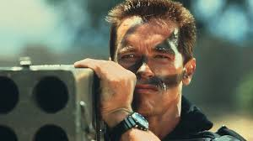

Genre Classification
CNN
CNN
Comedy,
Action
Action
CNN
Horror

Slide 2
General Steps
1. importing the data to environment(pandas)
2. Discarding irrelevant data.
3. Splitting the data to train and test sets.
4. deploying model of Convolutional Network.
5.Training the model.
6.deploying the results to test set.

Slide 3
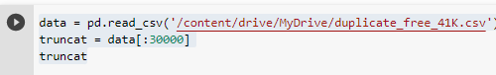
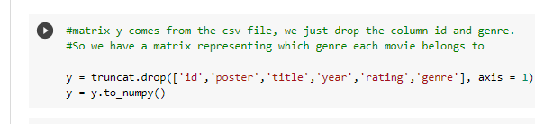
Data slicing(steps : 1,2,3)
30000 samples
Dropping irrelevant features

Slide 4
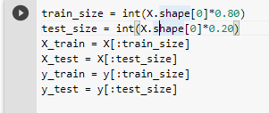
Train & Test set
Train set size = 30000*0.8 = 24000 training samples
Test set size = 30000*0.2 = 6000 test samples

Slide 5
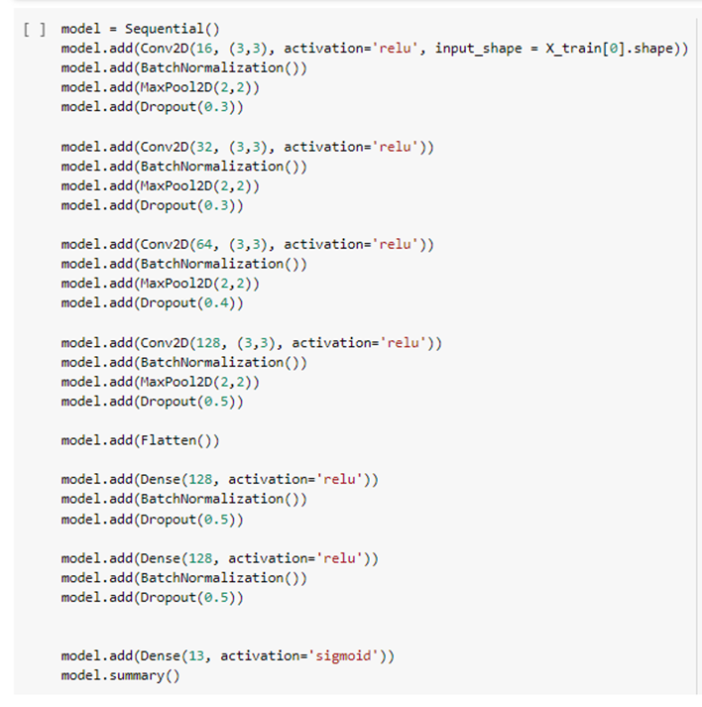
Convolutional Neural Network - model

Slide 6
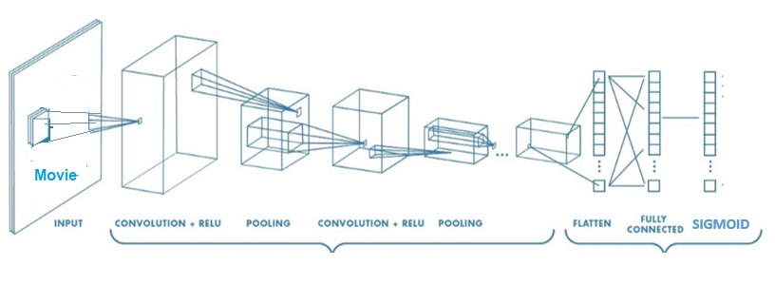



Model Visual Description
Action
Comedy
Horror
Sci Fi
.
.
.
4 Convolutional Layers. Sigmoid serves as an activation layer.

Slide 7
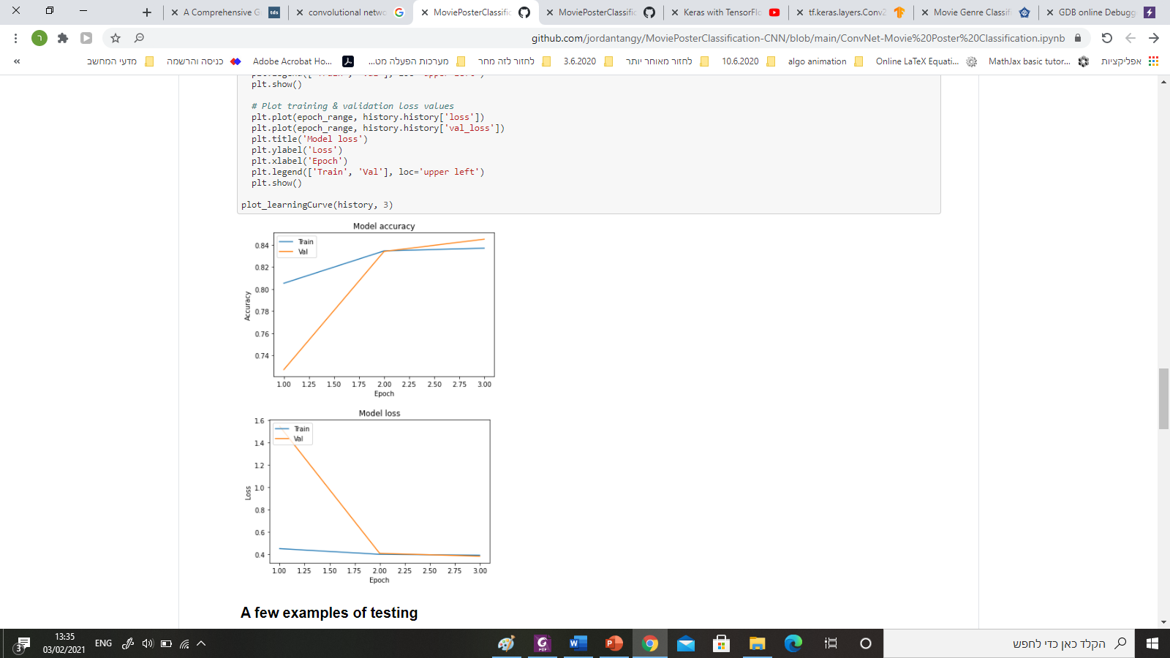
Results

